Slide 1
Banking structure
Of India
Presentation by:-
Ravi Bunkar

Slide 2
Contents:
Introduction
Functions of a bank
Generation of banking
Indian banking structure
New structure proposed by RBI

Slide 3

Introduction:
A bank is a financial institution accepting and safe guarding money owned by the individuals and entities and lending out this money in order to earn profit.

Slide 4

Functions of Banking:
Acceptance of deposit.
Granting loans.
Issuing banknotes, currency exchange.
Other function.

Slide 5
Generation of Banking
Phase 1
1770-1969
Phase 2
1969-1991
Phase 3
1991 – till now

Slide 6
Phase 1 1770-1969
Year | Formation of Bank
1770 | Bank of Hindustan.
1786 | General Bank of India.
1809 | Bank of Bengal.
1840 | Bank of Bombay
1843 | Bank of Madras
1865 | Allahabad Bank
1895 | Punjab National Bank.
1921 | Imperial Bank of India.
1935 | Reserve Bank of India.
1955 | State Bank of India.

Slide 7
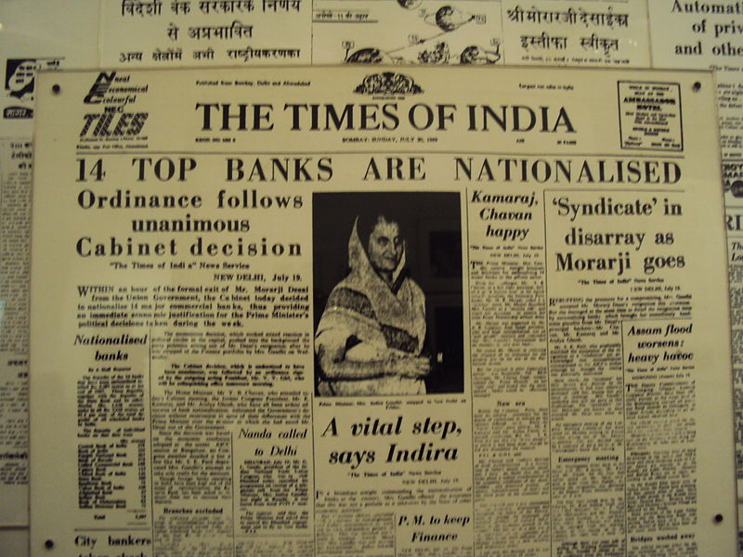
Phase 2 1969-1991
On July 19 1969 under directions from the then prime minister mrs.indira gandhi 14 major commercial banks were nationalized.
In 15th April 1980 6 more banks were nationalized

Slide 8

List of Nationalised Bank
Bank of India Canara Bank Central Bank of India Corporation bank Indian Bank Indian overseas bank
Dena Bank Oriental Bank of Commerce Punjab & Sind Bank Union Bank of India United Bank of India Vijaya Bank New Bank of India
Syndicate Bank
UCO Bank Allahabad Bank Andhra Bank Bank of Baroda Bank of Maharashtra

Slide 9
Phase 3 1991 onwards
Liberalization of banks norms.
Ceiling on term loan was Raised to rs 10000 million.
Banks were allowed to set their own interest.
Banks were allowed to fix own foreign exchange.
Loan system was introduced for delivery of bank credit.

Slide 10
Rules to start a bank (nationalized Bank)
The requirements for the issue of a bank license vary between jurisdictions but typically include:
Minimum capital
Minimum capital ratio
'Fit and Proper' requirements for the bank.
Approval of the bank's business plan.

Slide 11

Types of Banks
And their Functions

Slide 12
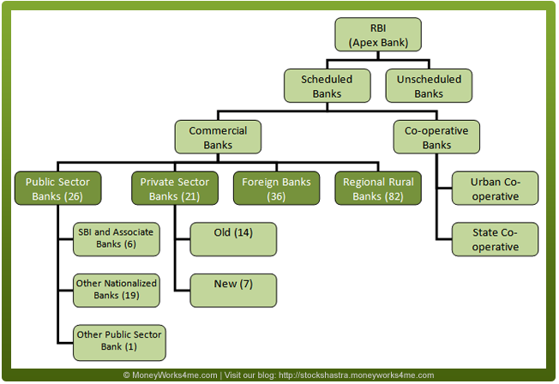

Slide 13

RBI
Reserve Bank of India is the apex bank of india.
Created in 1935, by passing RBI Act 1934 by the recommendations of HILTON-YOUNG COMMISSION.
Empowered as central bank in 1949.
administers the government's monetary policy.
granting licenses for new bank branches.
Issues currency for the government.

Slide 14
Banking structure
Scheduled banks
A Scheduled Bank is that which has been included in the Second Schedule of the Reserve Bank of India Act, 1934 and fulfills the three conditions :
has paid-up capital and reserves of at least Rs. 5 lakhs
its operations are not detrimental to the interest of the depositors.
It is a corporation or a cooperative society and not a partnership or a single owner firm
Unscheduled banks
The banks which are not included in the Second Schedule of the Reserve Bank of India Act are non-scheduled banks.

Slide 15
Schedule banks are divided into
Commercial Bank
The banks, which perform all kinds of banking business and generally finance trade and commerce, their deposits are for a short period .
They are divided into :
1. Public sector.
2. Private sector.
3. foreign banks.
4. Regional rural bank.
Cooperative Bank
Cooperative banks are operated on the cooperative lines.They are setup for the purpose of development and welfare.
Example:
-Central cooperative bank.
-Urban cooperative bank.
-State cooperative bank.
-Land Development bank.
-Primary Agriculture credit
society.

Slide 16
Public Sector Bank
These are owned and controlled by the government. In India, the nationalized banks and the regional rural banks come under these categories.
Private Sector Bank
These banks are owned by the private individuals or corporations and not by the government or co-operative societies.

Slide 17

Foreign Bank
1. ABN AMRO 2. BNP Paribas 3. Citibank India 4. HSBC (Hongkong & Shanghai Banking Corporation) 5. JPMorgan Chase Bank 6. Bank of America 7. Standard Chartered Bank 8. Barclays Bank 9. Deutsche Bank 10. Royal Bank of Scotland

Slide 18
Regional Rural Bank
Regional Rural Banks are the bank operated in different states of India. They have been created to serve the rural areas with banking and financial services.
Example
1.Regional Rural Banks in Madhya Pradesh 2.Jhabua Dhar Kshetriya Gramin Bank 3.Madhya Bharat Gramin Bank 4.Mahakaushal Kshetriya Gramin Bank 5.Narmada Malwa Gramin Bank 6.Rewa-Sidhi Gramin Bank

Slide 19
4-Tier Structure of Bank
Recently Proposed by RBI

Slide 20
Level 2
Level 1
Level 4
Level 3
Large Bank
Level 2
Level 1
Level 4
Level 3
Mid –Sized Bank
Private Sector ,Regional Rural & Cooperative Bank
Private Owned &Local Banks

Slide 21
Tier 1
The first tier may consist of three or four large Indian banks with domestic and international presence along with branches of foreign banks in India
Tier 2
It includes those banks are capable of offering a broad range of banking products and services to the domestic economy .

Slide 22
Tier 3
The third tier would have old private sector banks, regional rural banks and multi-state urban cooperative banks (UCBs).
Tier 4
The fourth tier may consist of many small privately owned local banks and cooperative banks.

